Slide 1
Online Examination Portal

Slide 2
Contents:
Technology Used
Abstract
Teacher login
Steps to create new test
Steps to view results of test
Student Login
Steps to give a test
Steps to view test result
Conclusion

Slide 3
Technology Used
HTML5
CSS3
PHP
JAVASCRIPT
AJAX
PHPMYADMIN
HOSTING SITE

Slide 4
Abstract:
There are many websites which provides online examination services. One of the best examples of such websites is Testyou.in . But such websites do not provides examination services to any specific university/college/department, anyone can use these services. Hence, our main aim is to develop an online examination portal for Department of IT, FAMT so that it will helpful to our teachers.

Slide 5
Structure of website
Teacher section
Create new test
View test results
Student section
Give test
View results of previous tests

Slide 6
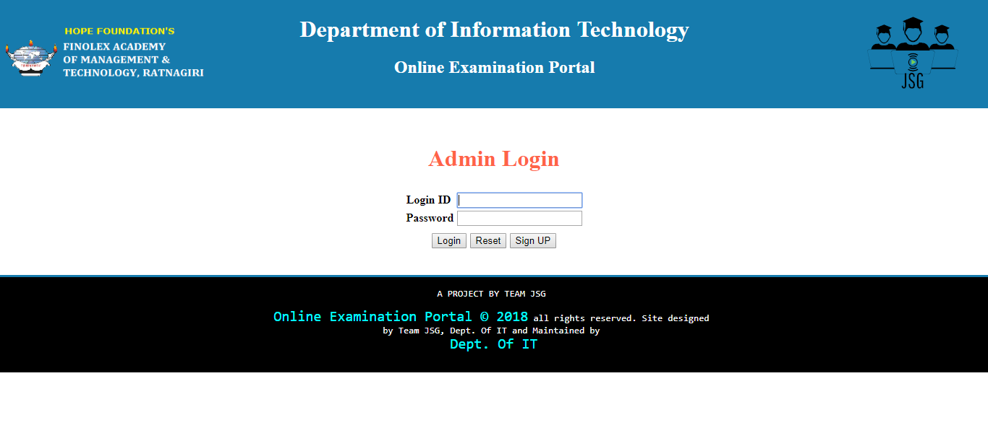
Teacher login

Slide 7
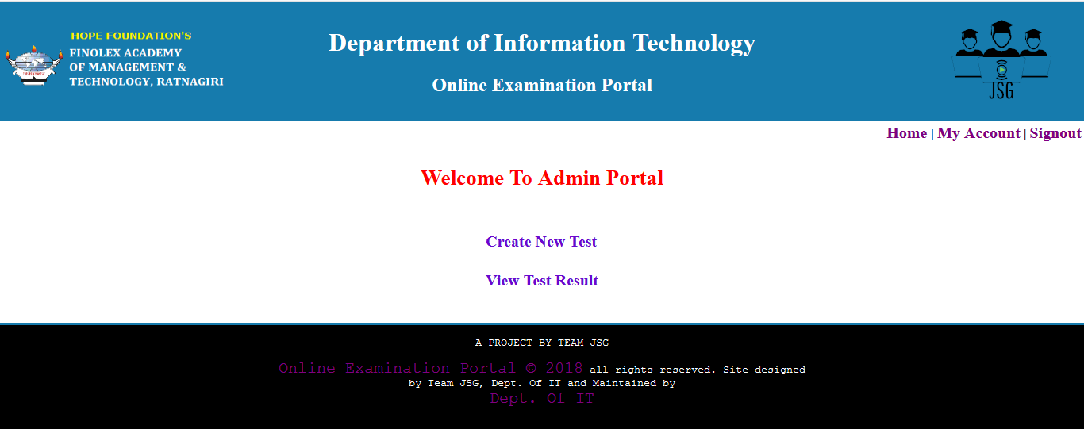
After login

Slide 8
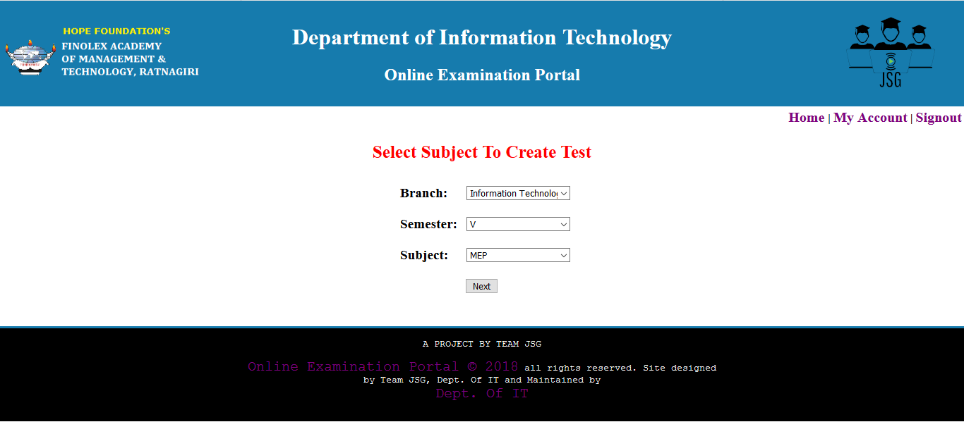
Steps to create new test: Step 1) Select branch, semester and subject

Slide 9
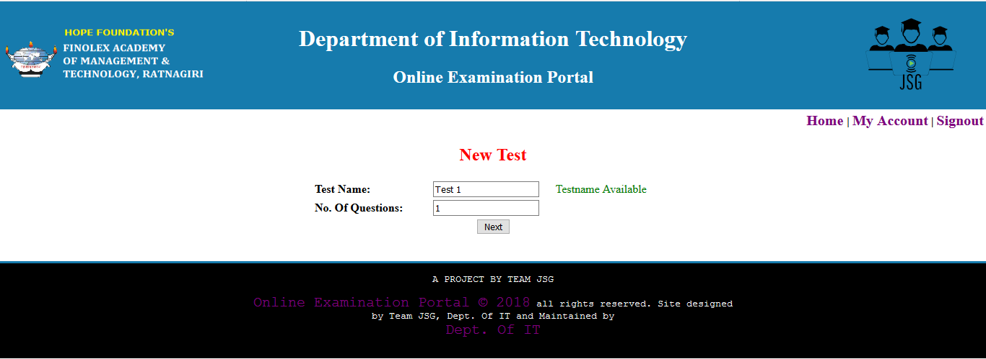
Step 2) Give test name and no. of questions in the test

Slide 10
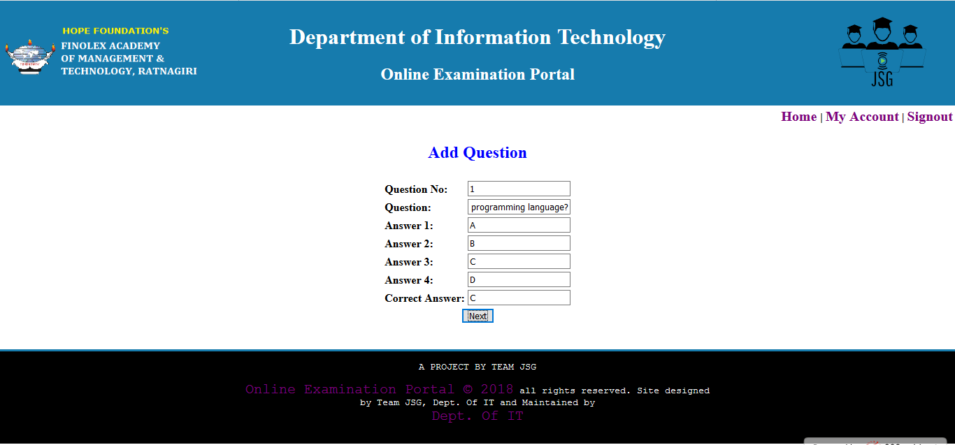
Step 3) Fill all the details of questions

Slide 11
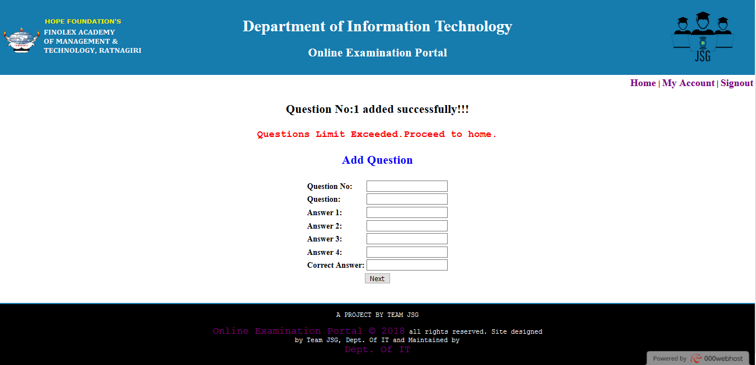
Step 4) Questions added successfully

Slide 12
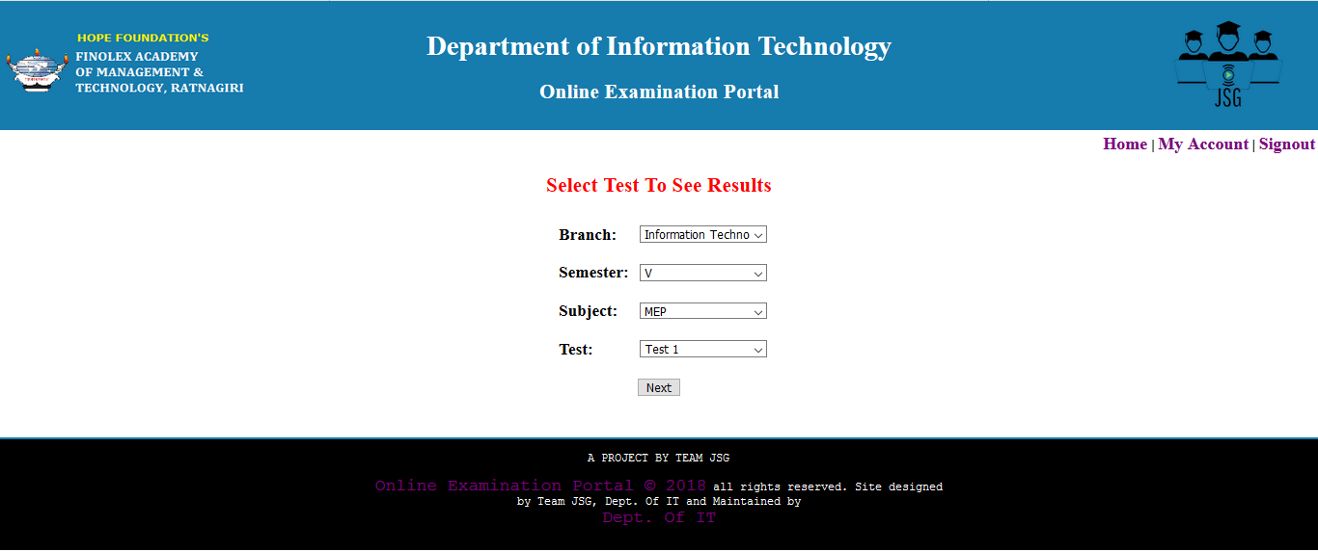
Steps to view result: Step 1) Select branch and semester

Slide 13
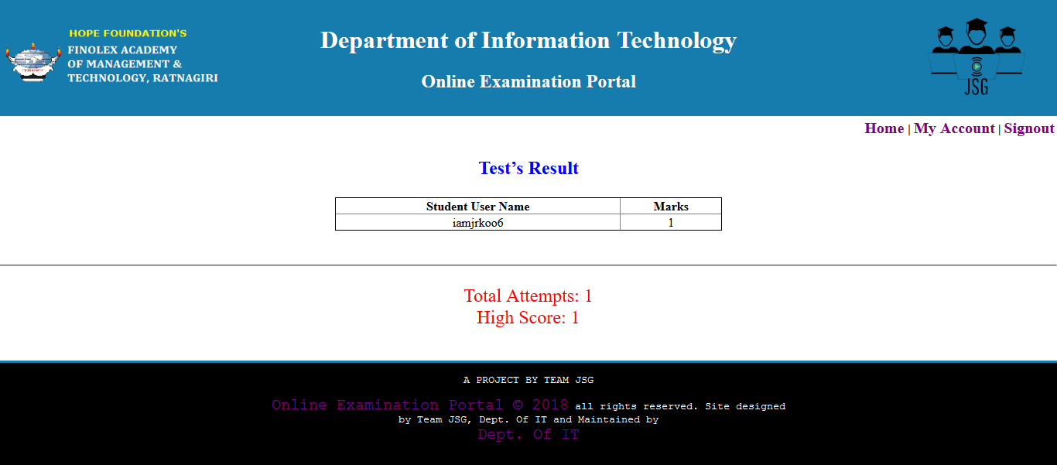
Step 2) View result of the test

Slide 14
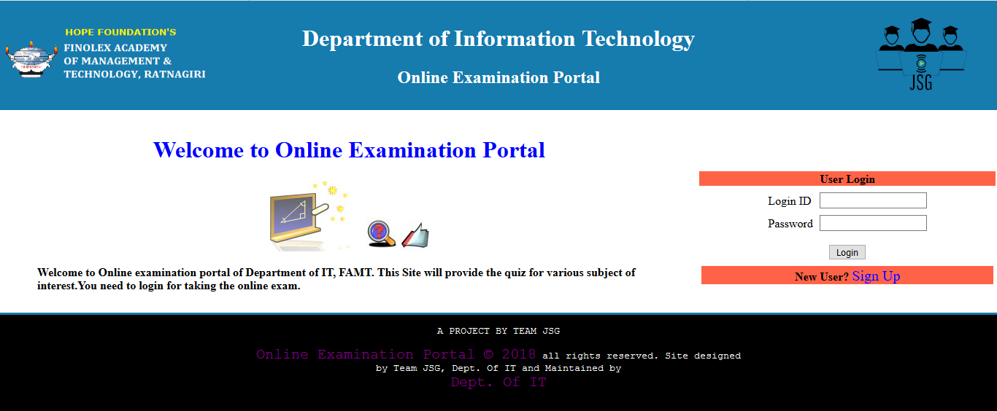
Student login

Slide 15
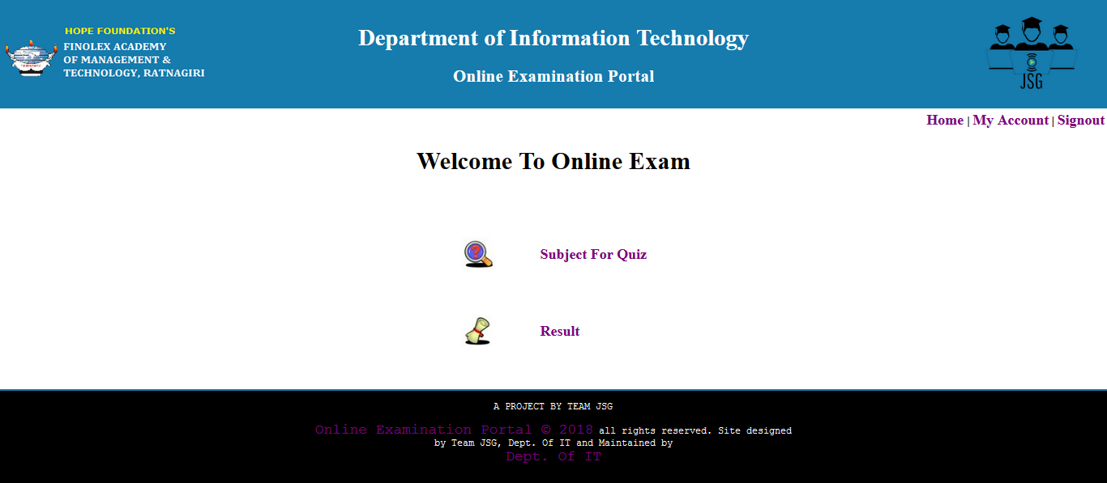
After login

Slide 16
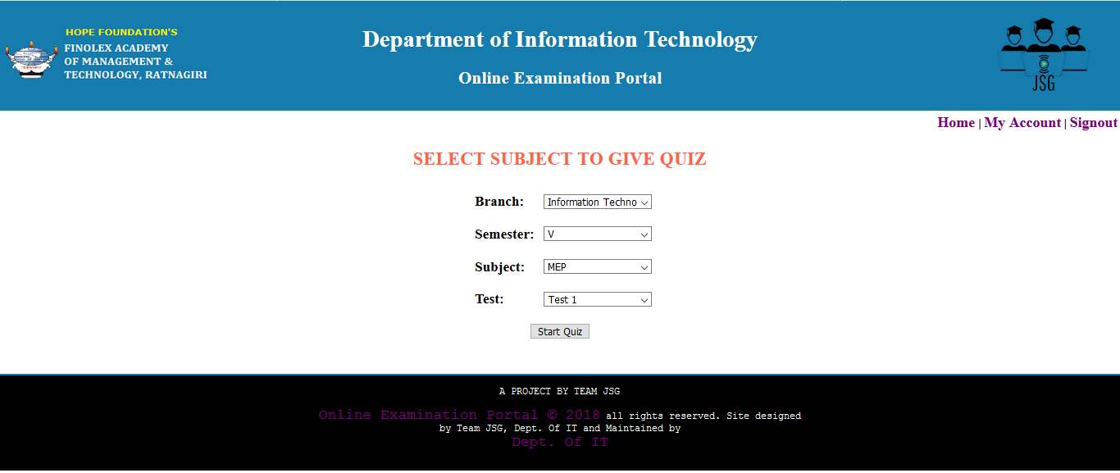
Steps to create new test: Step 1) Select branch, semester, subject and test

Slide 17
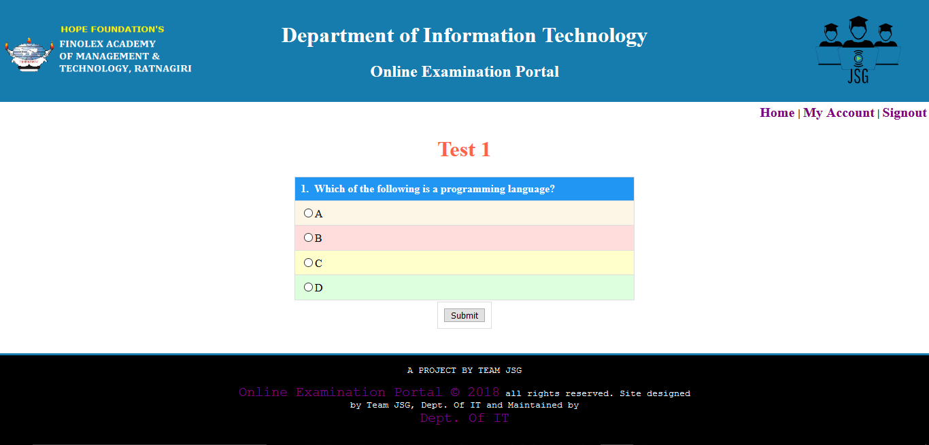
Step 2) Attempt all of questions in the test and submit the test

Slide 18
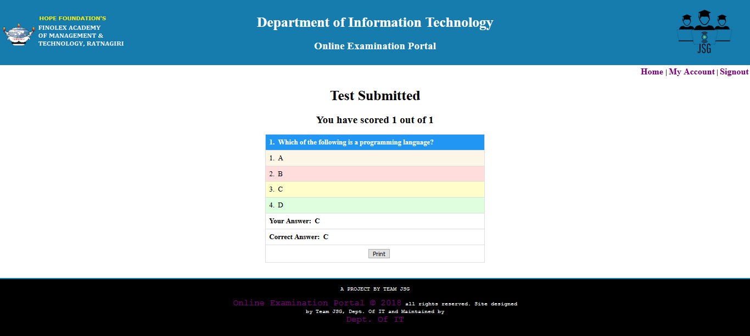
Step 3) View the result after test submit and student can print the result

Slide 19
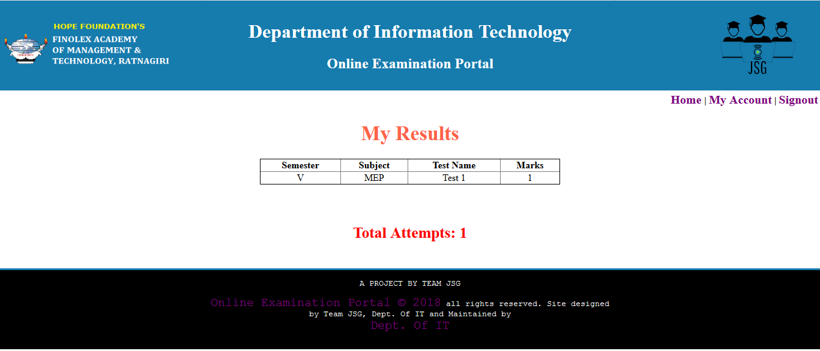
Student can view all of his/her previous results by clicking on results in student home.

Slide 20
Conclusion
It is useful examination portal
It gives optimum results
It provides departmental or college use only
It can achieve wider use
It decreases dependencies of teacher on other examination portal

Slide 21
Thank You

